Slide 1

Consumer Behavior: Buying, Having, and Being
Twelfth Edition
Chapter 3
Perception
Copyright © 2017, 2015, 2013 Pearson Education, Inc. All Rights Reserved.
Notes:
If this PowerPoint presentation contains mathematical equations, you may need to check that your computer has the following installed:
1) MathType Plugin
2) Math Player (free versions available)
3) NVDA Reader (free versions available)
This chapter defines the scope of international business and introduces us to some of its most important topics.

Slide 2
Learning Objectives (1 of 2)
3.1 The design of a product today is a key driver of its success or failure.
3.2 Products and commercial messages often appeal to our senses, but because of the profusion of these messages we don’t notice most of them.
3.3 Perception is a three-stage process that translates raw stimuli into meaning.

Slide 3
Learning Objectives (2 of 2)
3.4 Subliminal advertising is a controversial—but largely ineffective—way to talk to consumers.
3.5 We interpret the stimuli to which we do pay attention according to learned patterns and expectations.
3.6 The field of semiotics helps us to understand how marketers use symbols to create meaning.

Slide 4

Learning Objective 3.1
The design of a product is often a key driver of its success or failure.

Slide 5

Sensation
Vision
Scent
Sound
Touch
Taste
Hedonic consumption
Context effects
Notes:
Our senses play quite a role in the decisions marketers make. For instance, marketers rely heavily on visual elements in advertising, store design, and packaging. They communicate meanings on the visual channel through a product’s color, size, and styling. An interest in scent has spawned new products. Some brands utilize scent easily. For instance, Starbucks requires baristas to grind a batch of coffee each time they brew a post instead of just once each morning to ensure customers have that intense smell during their Starbucks’ experience. Stores and restaurants often play certain kinds of music to create a certain mood. Recent research found that participants who simply touch an item for 30 seconds or less had a greater level of attachment with the product. This connection in turn boosted what they were willing to pay for it. A food item’s image and the values we attach to it influence how we experience the actual taste. These aspects can be called a brand’s sensory system. We’ll cover these 5 aspects of branding in learning objectives one and two.
Hedonic consumption includes how consumers interact with the emotional aspects of products. In other words, products are rarely strictly functional. Consumers may want hedonic value too. Target is a company that has embraced this insight. Target focuses on products with great design as well as functionality.
The Coca-Cola bottle also illustrates an example of how design can facilitate product success.

Slide 6
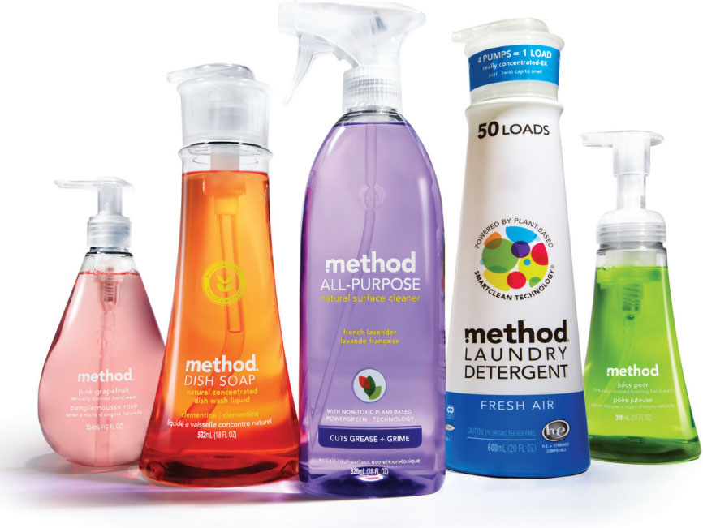
Sensory Marketing
Companies think carefully about the impact of sensations on our product experiences.
Notes:
Marketers rely heavily on visual elements in advertising, store design, and packaging. Many of our reactions to color come from learned associations. These are cultural connotations such as the color black for mourning. But other reactions are biological. Women tend to be drawn to brighter colors, for instance. Because colors are so powerful, they are an important concern in packaging design. Ultimately they can become a part of a company’s trade dress.

Slide 7
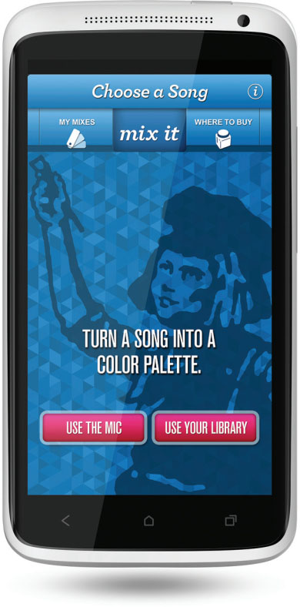
Vision (1 of 2)
Trade dress
Color forecasts
Notes:
Trade dress is when some color combinations come to be so strongly associated with a corporation. Example – the blue box/bag from Tiffanys
Color forecasts are colors that manufacturers and retailers buy so they can be sure they stock up on the next hot hue. For example, Pantone, Inc. (one of these color arbiters)
identified “Marsala”—a naturally robust and earthy wine red—as the color of the year for 2015.

Slide 8
Vision (2 of 2)
Table 3.1 Marketing Applications of Colors
Color | Associations | Marketing Applications
Yellow | Optimistic and youthful | Used to grab window shoppers’ attention
Red | Energy | Often seen in clearance sales
Blue | Trust and security | Banks
Green | Wealth | Used to create relaxation in stores
Orange | Aggressive | Call to action: subscribe, buy or sell
Black | Powerful and sleek | Luxury products
Purple | Soothing | Beauty or anti-aging products
Source: Adapted from Leo Widrich, “Why Is Facebook Blue? The Science Behind Colors in Marketing,” Fast Company (May 6, 2013), fastcompany.com accessed February 23, 2015.

Slide 9
Dollars and Scents
Like color, odor can also stir emotions and memory.
Scent Marketing is a form of sensory marketing that we may see in lingerie, detergents, and more.
Notes:
Marketers are seeking ways to exploit the power of scent. You may notice products with scent such as aircraft cabins. A consistent scent could ultimately register with consumers as a brand’s sensory signature.

Slide 10
For Reflection (1 of 8)
Imagine you are the marketing consultant for the package design of a new brand of premium chocolate.
What recommendations would you make regarding sight and scent?

Slide 11
Learning Objective 3.2
Products and commercial messages often appeal to our senses, but because of the profusion of these messages, we don’t notice most of them.
Notes:
Sensory marketing means that companies pay extra attention to how our sensations affect our product experiences. Marketers recognize that our senses help us to decide which products appeal to us. In addition to scent and sight, sound, touch, and taste are also relevant.

Slide 12

Key Concepts in Use of Sound
Audio watermarking
Sound symbolism
Phenomes
Notes:
There are many aspects of sound relevant to marketers. Brands can use audio watermarking to encourage the retention of the message- when producers weave a sound/motif into a piece of music that acts like an earworm we compulsively hum.
Sound symbolism as a way to influence brand image with sound. Sounds can even influence how we feel about size! Consumers are more liekly to recognize brand names that begin with a hard consanant (K or P). Vowel and consonant sounds (or phenomes) can even be associated with perceptions of large and small.

Slide 13

Key Concepts in the Use of Touch
Endowment effect
Haptic
Kansei engineering
Notes:
Research has shown that when consumers touch a product, they then have a higher level of attachment to the product. Touch can even influence sales interactions. Consumer researchers are studying the role that haptic sense (touch) plays in consumer behavior. Basically, we are more sure about what we perceive if we can touch it. We have a tendency to want to touch objects. The philosophy of computer design related to touch is known as natural user interface and it incorporates habitual human movements that we don’t have to learn.
Some Japanese companies take this idea a step farther with their practice of Kansei engineering, a philosophy that translates customers’ feelings into design elements.

Slide 14
For Reflection (2 of 8)
Some studies suggest that as we age, our sensory detection abilities decline. What are the implications of this phenomenon for marketers who target elderly consumers?

Slide 15
For Reflection (3 of 8)
How has your sense of touch influenced your reaction to a product?
Which of your senses do you feel is most influential in your perceptions of products?

Slide 16
Learning Objective 3.3
Perception is a three-stage process that translates raw stimuli into meaning.
Notes:
The three stages of perception are exposure, attention, and interpretation. The image is related to Gary’s story as he traveled abroad and sought out milk as his beverage of choice. Many countries use ultra heat treated (UHT) milk, which allows milk to be stored as a shelf-stable product. Gary rejects the milk. Why? He’s learned to equate the cold temperature of refrigerated milk with freshness, so he experienced a negative physical reaction when confronted with a product that contradicted his expectations. This is all part of the perception process.

Slide 17
Stages of Perception
Exposure
Attention
Interpretation
Notes:
Exposure occurs when a stimulus comes within the range of someone’s sensory receptors.
We will review Attention and Interpretation on the following slides.

Slide 18
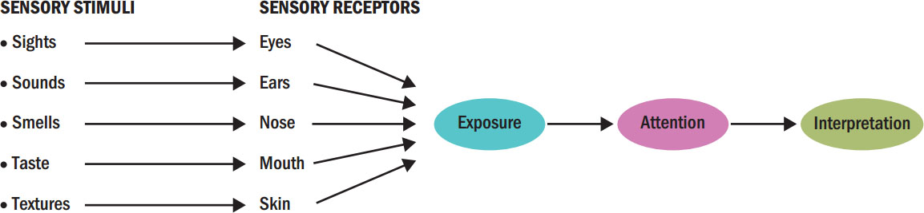
Figure 3.1 Perceptual Process
Notes:
Figure 3.1 shows how as consumers we are exposed to sensory stimuli through our sensory receptors. We then interpret those stimuli to which we paid attention. This image also emphasizes the three key stages of perception: exposure, attention, and interpretation.

Slide 19
Stage 1: Key Concepts in Exposure
Sensory threshold
Psychophysics
Absolute threshold
Differential threshold
JND
Weber’s Law
Notes:
Exposure occurs when a stimulus comes within the range of someone’s sensory receptors.
What a person is capable of receiving is stimuli within a person’s sensory threshold. That threshold is the area within which stimuli can make a conscious impact on the person’s awareness.
The science of psychophysics focuses on how people integrate the physical environment into their personal worlds.
The absolute threshold refers to the minimum amount of stimulation a person can detect on a given sensory channel. The absolute threshold means that the stimulation used by marketers must be sufficient to register. For instance, a highway billboard might have the most entertaining copy ever written, but this genius is wasted if the print is too small for passing motorists to see it.
The differential threshold refers to the ability of a sensory system to detect changes in or differences between two stimuli. The minimum difference we can detect between two stimuli is the j.n.d. (just noticeable difference).
Sometimes a marketer may want to ensure that consumers notice a change, as when a retailer offers merchandise at a discount. In other situations, the marketer may want to downplay the fact that it has made a change, such as when a store raises a price or a manufacturer reduces the size of a package.
A consumer’s ability to detect a difference between two stimuli is relative. A psychophysicist named Ernst Weber found that the amount of
change required for the perceiver to notice a change systematically relates to the intensity of the original stimulus. The stronger the initial stimulus, the greater a change must be for us to notice it. This relationship is known as Weber’s Law.

Slide 20


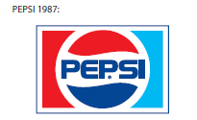
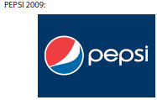
The Pepsi Logo Over Time
Notes:
Exposure occurs when a stimulus comes within the range of someone’s sensory receptors. Consumers concentrate on some stimuli, but are unaware of others. There are some stimuli we simply cannot perceive. Psychophysics is the science that explains how the physical environment is integrated into our personal, subjective world. When we define the lowest intensity of a stimulus that our brains can register we are speaking of its threshold. The images in the slide illustrate how Pepsi has changed its logo over the years. If the difference didn’t pass our sensory threshold, we wouldn’t notice the logo had changed.

Slide 21
For Reflection (4 of 8)
How much of a change would be needed in a favorite brand’s price, package size, or logo would be needed for you to notice the difference?
How would differences in these variables affect your purchase decisions?

Slide 22
Learning Objective 3.4
Subliminal Advertising is a controversial - but largely-perceived ineffective - way to talk to consumers.

Slide 23
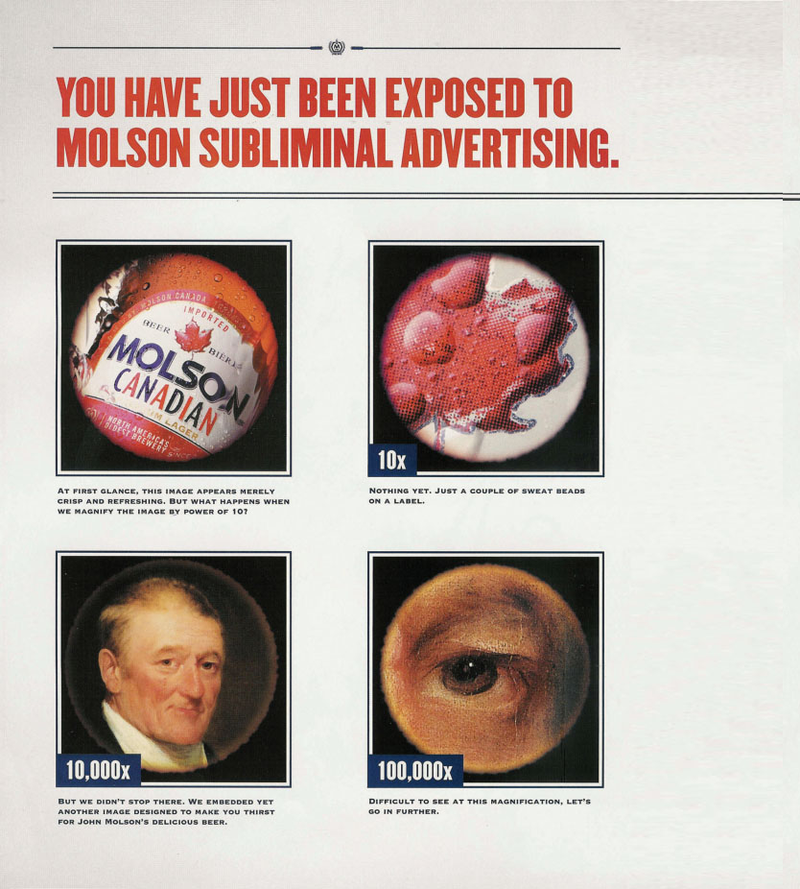
Subliminal Perception
Embeds

Slide 24
Stage 2: Attention
Attention is the extent to which processing activity is devoted to a particular stimulus
Consumers experience sensory overload
Marketers need to break through the clutter
Notes:
Attention refers to the extent to which processing activity is devoted to a particular stimulus. The allocation of processing activity can vary depending on the characteristics of the stimulus and the recipient. Although we live in an information society, consumers are often in a state of sensory overload. Sensory overload means consumers are exposed to far more information than they can process. Much of this comes from commercial sources. We are exposed to thousands of advertising messages each day in addition to the other types of stimuli we sense. This camera ad from Singapore reminds us that consumers do tune out stimuli.

Slide 25
How Do Marketers Get Attention?
Personal Selection Factors
Experience
Perceptual filters
Perceptual vigilance
Perceptual defense
Notes:
Experience is the result of acquiring and processing stimulation over time. It helps to determine how much exposure to a particular stimulus a person accepts. Perceptual filters based on our past experiences influence what we decide to process. Perceptual filters include vigilance, defense, and adaptation.
Vigilance means consumers are more likely to be aware of stimuli that relate to their current needs. A consumer who rarely notices car ads will become very much aware of them when she or he is in the market for a new car.
The flip side of perceptual vigilance is perceptual defense . This means that people see what they want to see—and don’t see what they don’t want to see. If a stimulus is threatening to us in some way, we may not process it, or we may distort its meaning so that it’s more acceptable.
Adaptation can also affect attention; adaptation is discussed further on the next slide.
In addition to the receiver’s mindset, characteristics of the stimulus itself play an important role in determining what we notice and what we ignore. Marketers need to understand these factors so they can create messages and packages that will have a better chance of cutting through the clutter. Several characteristics can aid in enhancing the chances of a stimulus for being noticed including size, color, position, and novelty.

Slide 26
Factors Leading to Adaptation
Intensity
Duration
Discrimination
Exposure
Relevance
Notes:
Adaptation is the degree to which consumers continue to notice a stimulus over time. The process of adaptation occurs when consumers no longer pay
attention to a stimulus because it is so familiar. A consumer can “habituate” and require increasingly stronger “doses” of a stimulus to notice it. Several factors can lead to adaptation. Less intense stimuli have less sensory impact. Stimuli that require relatively lengthy exposure in order to be processed habituate because they require a long attention span. Simple stimuli habituate because they do not require attention to detail. Frequently encountered stimuli habituate as the rate of exposure increases. Stimuli that are irrelevant or unimportant habituate because they fail to attract attention.

Slide 27
Stimulus Selection Factors
Contrast
Size
Color
Position
Novelty
Notes:
In addition to the receiver’s mindset, characteristics of the stimulus itself play an important role in determining what we notice and what we ignore. Marketers need to understand these factors so they can create messages and packages that will have a better chance of cutting through the clutter. Several characteristics can aid in enhancing the chances of a stimulus for being noticed including size, color, position, and novelty.

Slide 28
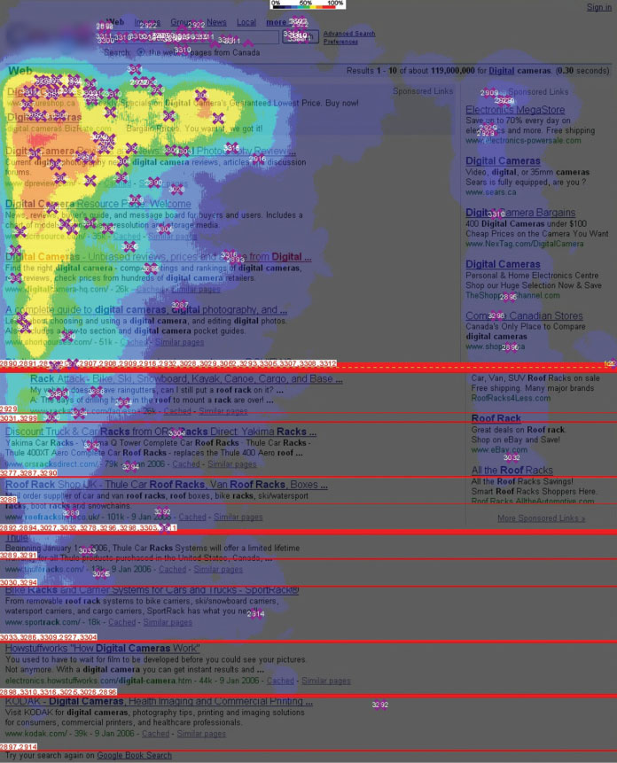
Figure 3.3 The Golden Triangle
Figure 3.3 The Golden Triangle
Eye-tracking studies reveal that people typically spend most of their time on a website looking at the “golden triangle” outlined by yellow, orange and red.
Source: Enquiro Search Solutions, Inc. (Now Mediative Performance LP).
Notes:
The Golden Triangle illustrates how our eyes view web sites.

Slide 29
For Reflection (5 of 8)
Do you think that subliminal perception works?
Under what conditions could it work?

Slide 30
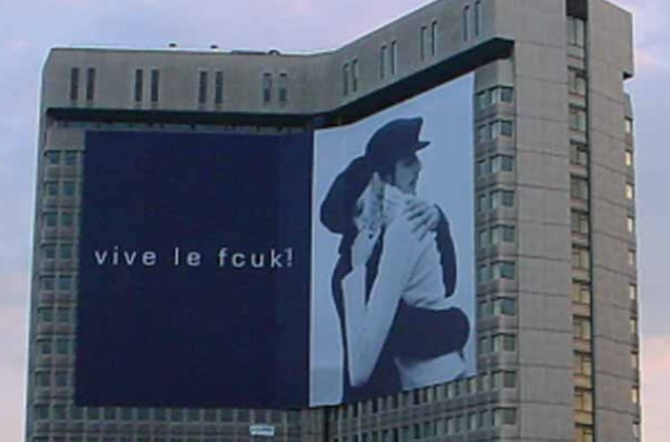
Learning Objective 3.5
We interpret the stimuli to which we do pay attention according to learned patterns and expectations.

Slide 31

Interpretation
Interpretation refers to the meaning we assign to sensory stimuli, which is based on a schema
Source: Client: XXXLutz; Head of Marketing: Mag. Thomas Saliger; Agency: Demner, Merlicek & Bergmann; Account Supervisor: Andrea Kliment; Account Manager: Albin Lenzer; Creative Directors: Rosa Haider, Tolga Buyukdoganay; Art Directors: Tolga Buyukdoganay, Rene Pichler; Copywriter: Alistair Thompson.
Notes:
The meaning we assign to a stimulus depends on the schema, or set of beliefs, to which we assign it. In a process called priming, certain properties of a stimulus evoke a schema. This leads us to compare the stimulus to other similar ones. When you first look at this add what is the word in blue? Now look at the spelling.

Slide 32
Stimulus Organization
Gestalt: The whole is greater than the sum of its parts
Closure: people perceive an incomplete picture as complete
Similarity: consumers group together objects that share similar physical characteristics
Figure-ground: one part of the stimulus will dominate (the figure) while the other parts recede into the background (ground)
Notes:
One factor that determines how we will interpret a stimulus is the relationship we assume it has with other events, sensations, or images in memory. Our brains tend to relate incoming sensations to others already in memory based on some fundamental organizational principles. These principles derive from Gestalt psychology, a school of thought that maintains that people interpret meaning from the totality of a set of stimuli rather than from an individual stimulus. The German word Gestalt roughly means whole, pattern, or configuration, and we summarize this term as the whole is greater than the sum of its parts. The Gestalt perspective provides several principles that relate to the way our brains organize stimuli including the closure principle, the principle of similarity, and the figure-ground principle.

Slide 33
For Reflection (6 of 8)
Give an example when you were affected my closure, similarity, or the figure ground principle.

Slide 34

Learning Objective 3.6
The field of semiotics helps us to understand how marketers use symbols to create meaning.

Slide 35
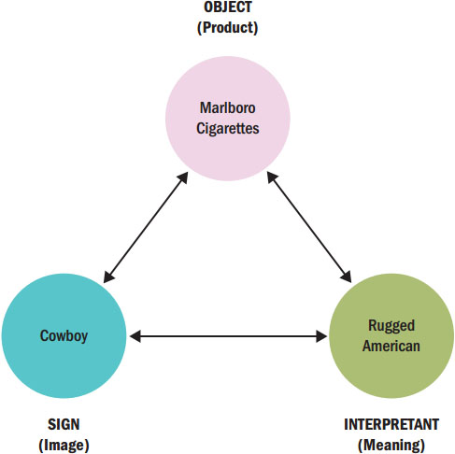
Figure 3.4 Semiotic Relationships
Object
Sign
Interpretant
Icon
Index
Symbol
Notes:
Semiotics, a discipline that studies the correspondence between signs and symbols and their roles in how we assign meanings.
The object is the product that is the focus of the message (e.g., Marlboro cigarettes). The sign is the sensory image that represents the intended meanings of the object (e.g., the Marlboro cowboy). The interpretant is the meaning we derive from the sign (e.g., rugged, individualistic, American). Figure 3.4 diagrams this relationship.
An icon is a sign that resembles the product in some way (e.g., the Ford Mustang has a galloping horse on the hood). An index is a sign that connects to a product because they share
some property (e.g., the pine tree on some of Procter & Gamble’s Spic and Span cleanser products conveys the shared property of fresh scent). A symbol is a sign that relates to a
product by either conventional or agreed-on associations (e.g., the lion in Dreyfus Fund ads provides the conventional association with fearlessness and strength that it carries [or
hopes to carry] over to the company’s approach to investments).

Slide 36
Examples of Brand Positioning
Lifestyle | Grey Poupon is “high class”
Price leadership | L’Oreal sells Noisome brand face cream
Attributes | Bounty is “quicker picker upper”
Product class | The Spyder Eclipse is a sporty convertible
Competitors | Northwestern Insurance is the quiet company
Occasions | Use Wrigley’s gum when you can’t smoke
Users | Levi’s Dockers targeted to young men
Quality | At Ford, “Quality is Job 1”
Notes:
When a marketer understands how consumers think about a set of competing brands, it can use these insights to develop a positioning strategy. Marketers can use many dimensions to carve out a brand’s position in the market place including lifestyle, price leadership, attributes, product class, competitors, occasions, users, and quality. Examples are noted in the slide.

Slide 37
For Reflection (7 of 8)
Think of a commercial you have recently seen and explain the object, sign and interpretant.
Notes:
Some research by clinical psychologists suggests that subliminal messages can influence people under very specific conditions, though it is doubtful that these techniques would be of much use in most marketing contexts. For this kind of message to have a prayer of working, an advertiser has to tailor it specifically to an individual rather than the mass messages suitable for the general public.

Slide 38
For Reflection (8 of 8)
How do your favorite brands position themselves in the marketplace?
Which possible positioning strategies seem to be most effective?

Slide 39
Chapter Summary
The design of a product affects our perception of it.
Products and messages may appeal to our senses.
Perception is a three-stage process that translates raw stimuli into meaning.
Subliminal advertising is controversial.
We interpret stimuli using learned patterns.
Marketers use symbols to create meaning.
Notes:
We’ve covered several key concepts in this chapter including perception, our perception is affected by our senses, subliminal advertising, and the factors which affect how we process symbols.

Slide 40

Copyright

